Slide 1

FLIGHT PRICE PREDICTION
SUBMITTED BY
Alivia dasgupta

Slide 2

Problem Statement:
Anyone who has booked a flight ticket knows how unexpectedly the prices vary. The cheapest available ticket on a given flight gets more and less expensive over time. This usually happens as an attempt to maximize revenue based on –
1. Time of purchase patterns (making sure last-minute purchases are expensive)
2. Keeping the flight as full as they want it (raising prices on a flight which is filling up in order to reduce sales and hold back inventory for those expensive last-minute expensive purchases)
So, you have to work on a project where you collect data of flight fares with other features and work to make a model to predict fares of flights.

Slide 3

Problem Understanding:
Flight prices are something unpredictable. It’s more than likely, that we spend hours on the internet searching for good deals. So, airline companies use complex algorithms to calculate flight prices given various conditions present at the particular time. Nowadays, the number of people using flights are increasing significantly. It gets difficult for the airline companies to maintain prices as they change dynamically due to various conditions. For that, we will use machine learning algorithms which can help to solve these problems. This can help airline companies to maintain their prices and also help the customers to predict future flight prices and accordingly plan their journey well in advance.

Slide 4

What is Flight Price Prediction?
Nowadays, the number of people using flights has increased significantly. It is difficult for airlines to maintain prices since prices change dynamically due to different conditions. That’s why we will try to use machine learning to solve this problem. This can help airlines by predicting what prices they can maintain. It can also help customers to predict future flight prices and plan their journey accordingly.

Slide 5

Review of Literature
It is hard for the client to buy an air ticket at the most reduced cost. The majority of systems are using the modern computerized techniques known as Machine Learning. I have scrapped the data from official online sites and based on that data, did analysis based on which, feature prices are changing and accordingly checked the relationship of flight prices with all the features

Slide 6

Exploratory Data Analysis:
As a first step I have scrapped the required data using selenium from easemytrip.com website.
1
And I have imported required libraries and I have imported the dataset which was in csv format.
2
Then I did all the statistical analysis like checking shape, nunique, value counts, info etc…..
3
While checking for null values I found there were null values in our dataset , which I filled using mode.
4
I have also droped Unnamed:0 column as it was not required.
5
Next as a part of feature extraction I converted the data types of datetime columns and I have extracted usefull information from the raw dataset.
6

Slide 7
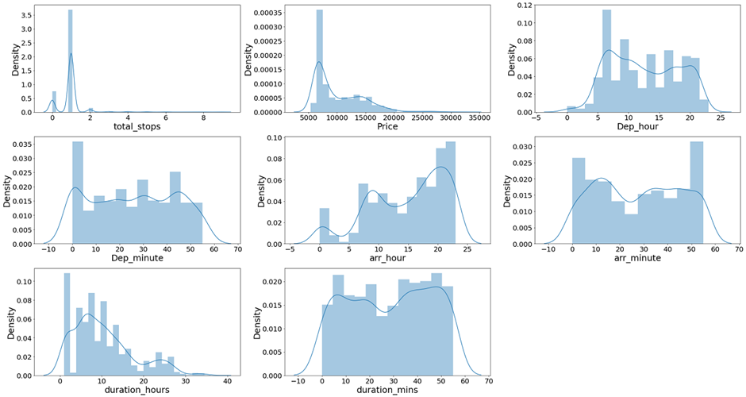
UNIVARIATE ANALYSIS
Distribution plot for numerical columns

Slide 8
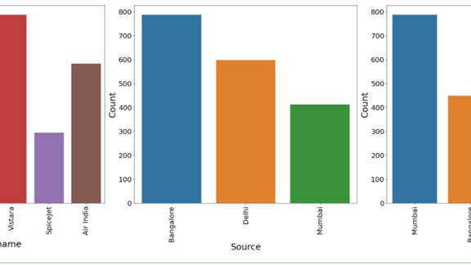
UNIVARIATE ANALYSIS
Bar Plot for categorical columns

Slide 9
UNIVARIATE ANALYSIS
Observations:
Vistara has maximum count which means most of the passengers preferred Vistara for there travelling.
Bangalore has maximum count for source which means maximum passengers are choosing Bangalore as there source.
Mumbai has maximum count for Destination which means maximum passengers are choosing Mumbai as there Destination.

Slide 10
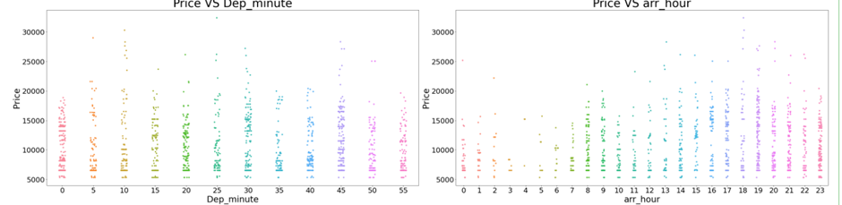
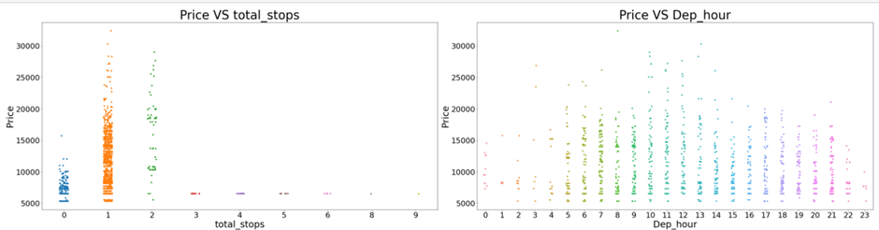
BIVARIATE ANALYSIS
Strip plot for numerical columns

Slide 11
BIVARIATE ANALYSIS
Observations:
1. Flights with 1 stop costs more price compared to other flights.
2. At noon time of every day the flight Prices are high so it looks good to book flights rather than noon.
3. And Departure minute has less relation with target Price.
4. At 7AM to 1PM Arrival time of every day the flight Prices are high so it looks good to book flights rather than this arrival time.
5. And Arrival minute has less relation with target Price.

Slide 12
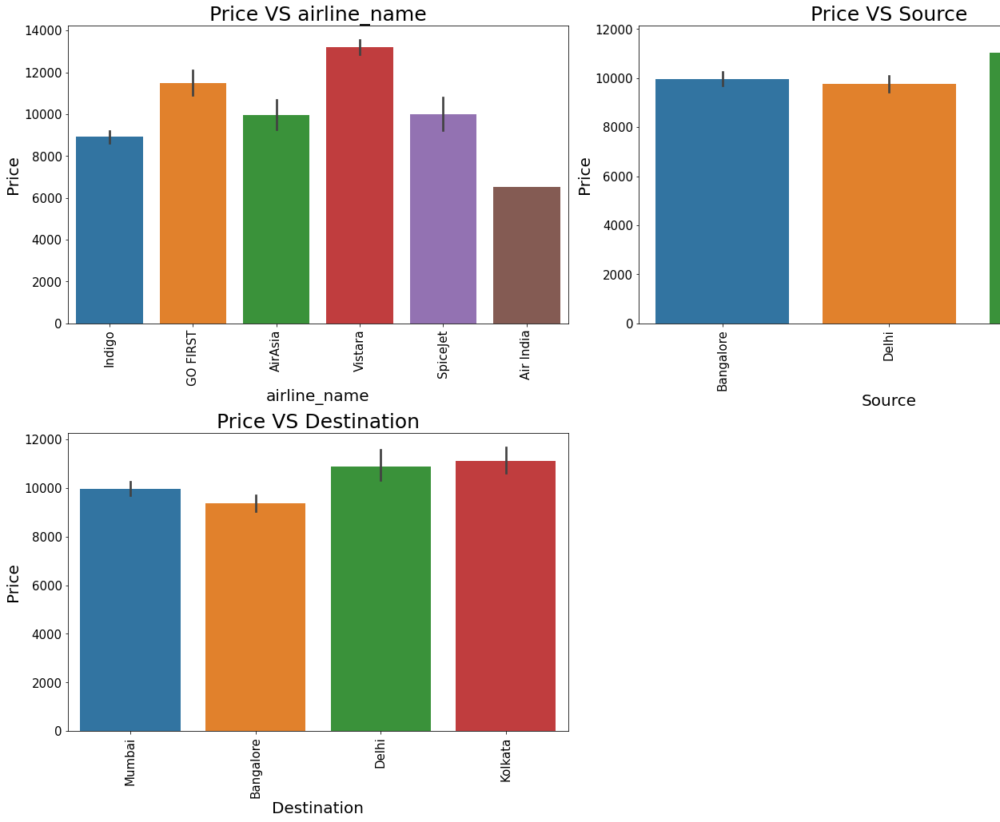
BIVARIATE ANALYSIS
Bar Plot for categorical columns

Slide 13
BIVARIATE ANALYSIS
Observations:
For Go First Airlines the Price is high compared to other Airlines.
All the Sources has approximately same prices.
Destination also has the approximately same prices.

Slide 14
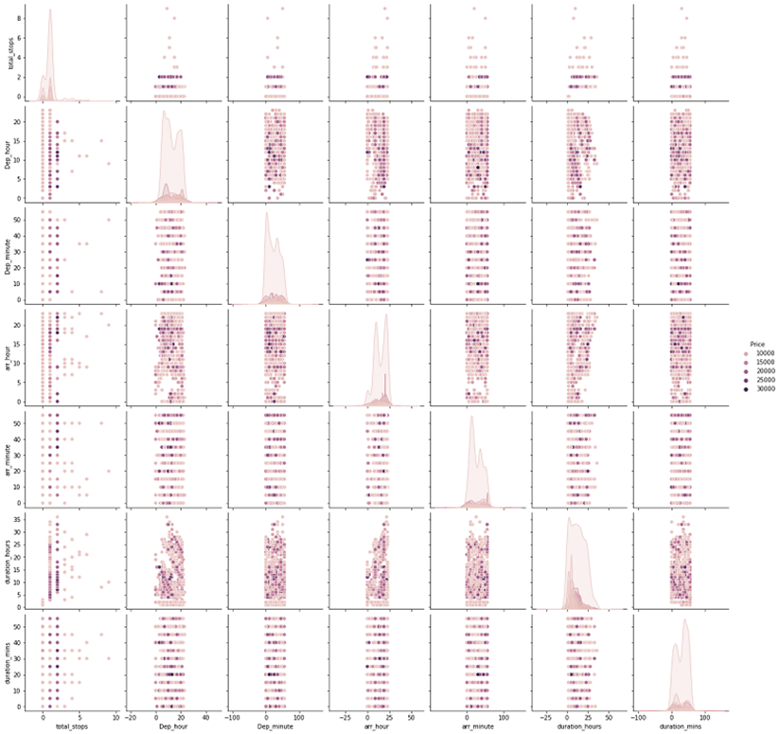
MULTI VARIATE ANALYSIS

Slide 15

Data Sources and their formats
The dataset is in the form of CSV (Comma Separated Value) format and consists of 10 columns (9features and 1 label) with 1794 number of records.
Airline Name - This shows the names of the airlines.
Date of Journey - Gives us the information about the journey date.
Source – Gives us the information about from where the flight will start( location).
Destination – Gives us the information about where the flight will land.
Stops – Shows the number of stops.
Duration – Shows how much time the flight takes to reach the destination.
Departure time – Shows the time when the flight will take off from the source location.
Arrival Time – Shows the time when the flight will reach the destination.
Price - Lists the price of the flights.
We can see our dataset includes a target label "Price" column and the remaining feature columns can be used to determine or help in predicting the price of the flights.

Slide 16
Data Pre-processing Done
Importing the necessary dependencies and libraries.
Reading the CSV file and converted into data frame.
Checking the data dimensions for the original dataset.
Looking for null values and accordingly fill the missing data.
Checking the summary of the dataset.
Checking unique values.
Checking all the categorical columns in the dataset
Checking for multi collinearity using VIF.
Performed Feature Importance using ExtraTrees Regression

Slide 17

Data Inputs- Logic- Output Relationships
The input data were all object type , so had to clean the data by initializing the prize column and converting the same into float type and ensuring all the categorical features are converted to numeric form with the help of LabelEncoder Method. Since most of the features were of categorical type, we did not have to worry much about skewness and outliers.

Slide 18
Model Building:
Since Price was my target and it was a continuous column with improper format which has to be changed to continuous float datatype column, so this perticular problem was Regression problem. And I have used all Regression algorithms to build my model. By looking into the r2 score and error values I found RandomForestRegressor as a best model with highest r2_score and least error values. Also to get the best model we have to run through multiple. Below are the list of Regression algorithms I have used in my project.
RandomForestRegressor
ExtraTreesRegressor
GradientBoostingRegressor
DecisionTreeRegressor
KNN

Slide 19
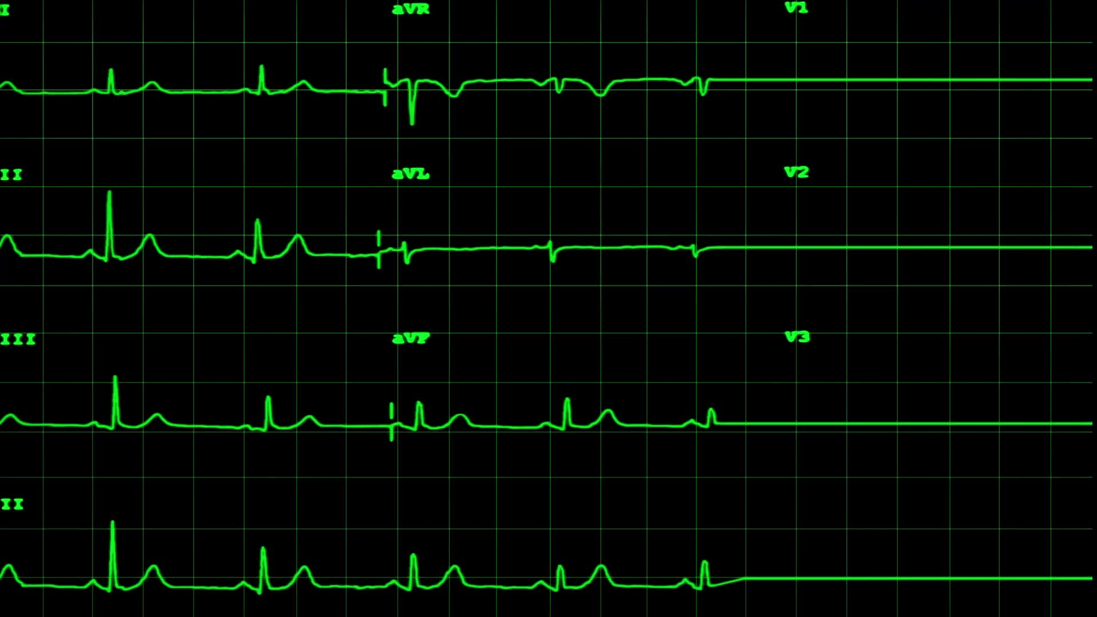
Interpretation
From the above EDA we can easily understand the relationship between features and can also determine which features are affecting the price of the flights.
In UNIVARIATE Analysis, I have used count plots to visualize the counts in categorical variables and distribution plots to visualize the numerical variables.
In BIVARIATE Analysis, I have used bar plots, to check the relation between label and the features.
Used pair plots to check the pairwise relation between the features.
The heat map and bar plot helped in understanding the correlation between dependent and independent variables.
Detected outliers and skewness with the help of box plots and distribution plots respectively.

Slide 20
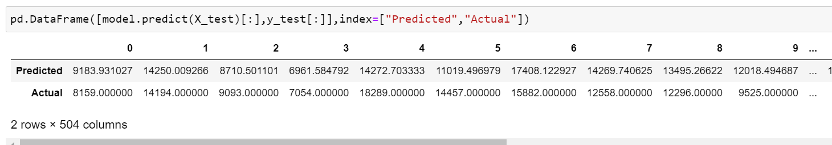
Prediction
After finalising the model Random Forest Regressor, I have taken the values of prices which are predicted by the model and compared with the actual Price values.

